Slide 1
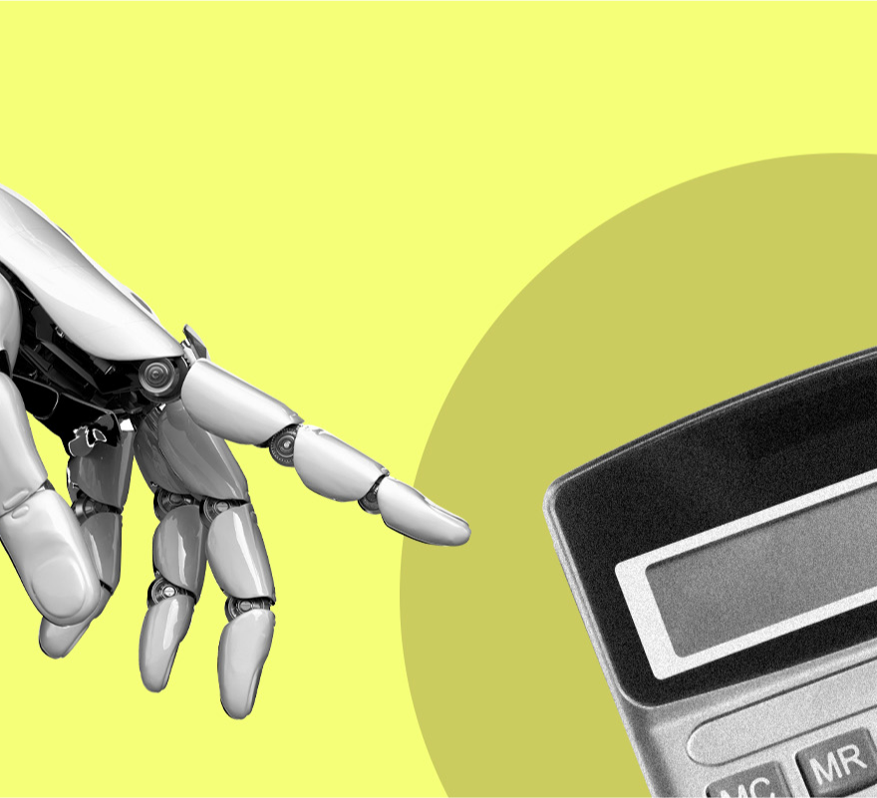
Expense AI
AI Empowered Automated Employee Expense Reimbursement Process
Team 13
Yiwei Wang
Bingyang Ke
Pengkun Ma
Nanxiang Zhao

Slide 2
Why AI Empowered Automated Employee Expense Reimbursement Process ?
Reduce human work
Reduce time cost
Discover fraud
Faster and smarter decision-making framework

Slide 3

Technique
Machine Learning
NLP
MDP

Slide 4
NLP Model
Extract Elements
ML
Predict Future Data
Neural Network
Predict Fraud Risk
MDP
Combine All Information
Inputs
Decisions
Database Stores Data

Slide 5
Extraction elements
?300.00
$300.0
€ 89.55
Jan 20, 2023
20/02/2023
Ergonomic Chairs
Skill Enhancement Programs
Regular expression
$300 in dollars
2023-02-20 in yyyy-mm-dd
Office Equipment & Supplies
Professional Development
NER

Slide 6
print the corresponding predict future InvoiceAmount
Collect the data of the combinations of Employee IDs and Expense Categories
inputs
futureDate
collect each combinations of all the corresponding of InvoiceDate and InvoiceAmount
SeasonalTrendRegressor Model to predict future InvoiceAmount

Slide 7
Component Analysis
Trend Model
Utilizes LinearRegression
Captures long-term data trends
Ignores seasonal fluctuations
Seasonal Model
Detrends data
Uses sine and cosine functions for seasonal features
Employs LinearRegression for seasonal fluctuations

Slide 8
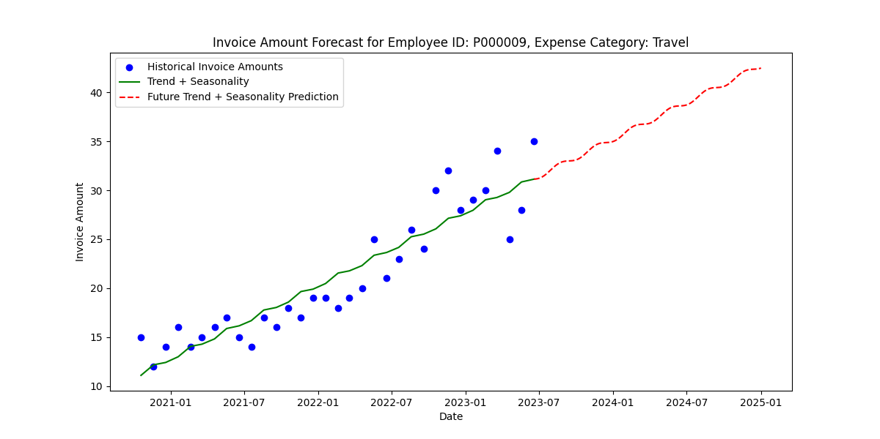
Test Case - EmployeeID: P000009, ExpenseCategory: Travel, FutureDate: 2025-01-01 Predicted Invoice Amount: 42.481312218726515

Slide 9
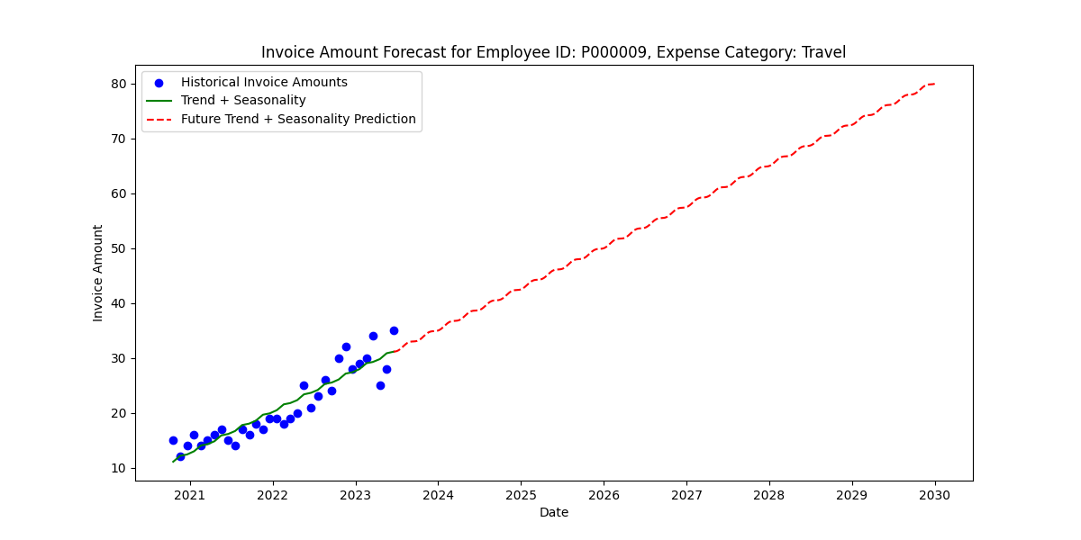
Test Case - EmployeeID: P000009, ExpenseCategory: Travel, FutureDate: 2030-01-01 Predicted Invoice Amount: 79.93473061985594

Slide 10
Model Advantages and Choice Reasons
Flexibility & Intuitiveness:
Combines trend and seasonal analysis using LinearRegression
Accuracy in Time Series Forecasting:
Effectively captures long-term trends and seasonal patterns
crucial for accurate financial data predictions.

Slide 11
Accessing Fraud Risk Score from invoice text ?
Consider fraud risk factors from invoices Feature Value
Weekend or holiday expenses? 0 / 1
Submitting the same invoice multiple times? 0 / 1
unusual spending - person is not associated on that project? 0 / 1
amount overclaim ? 0 / 1
amount is multiple of 100? 0 / 1
contain personal expense words 0 / 1
Invoice Date falls outside of Project Duration Dates 0 / 1
rounding amounts repeatedly claimed by same person? 0 --1
sudden change in behavior ? 0 – 1
And More……..

Slide 12
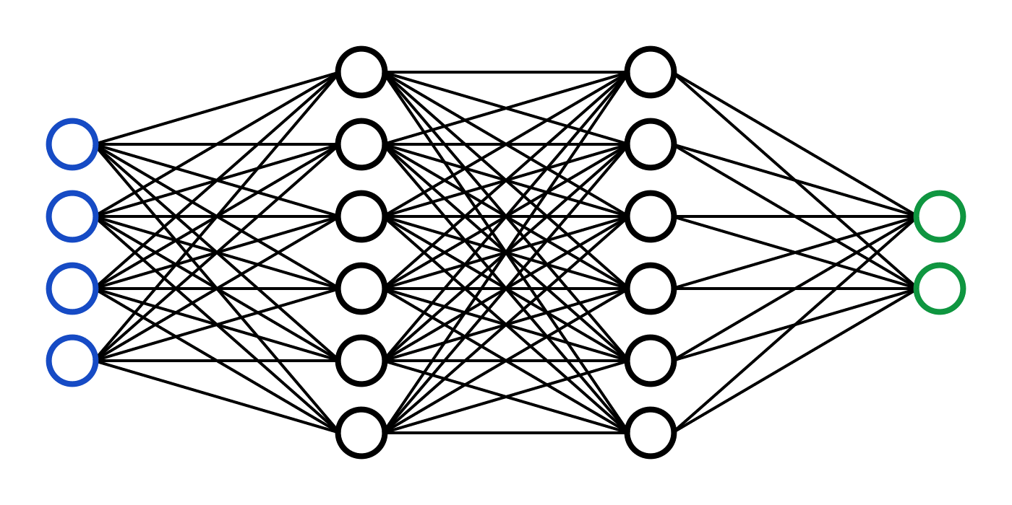
Fraud Risk Prediction
0, 1
0~1
0,1,2,3
[1,0,0,0] [0,1,0,0]

Slide 13
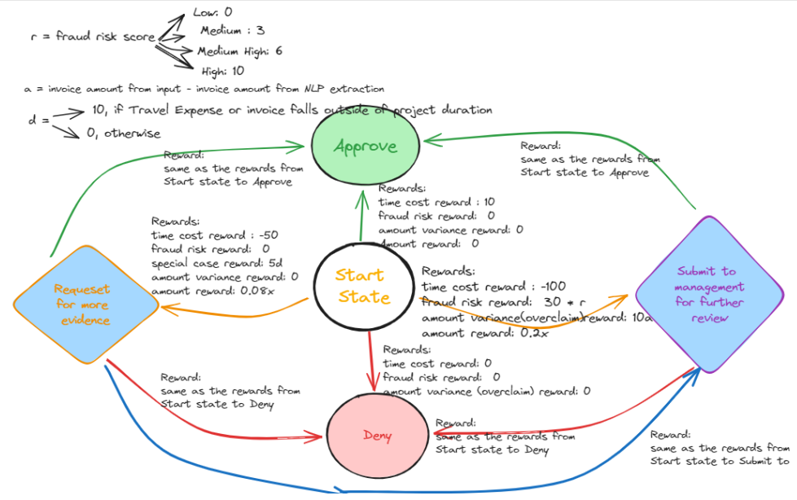
Submit for further review
Request for more evidence
Approve
Deny
start

Slide 14
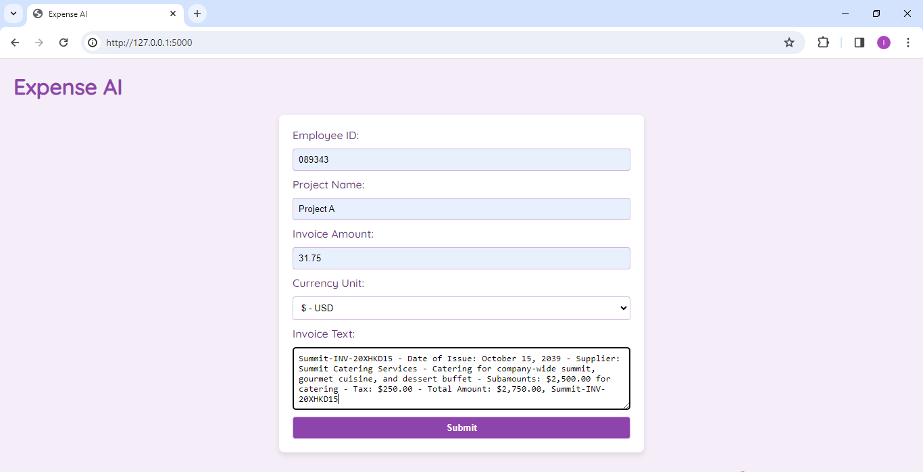
Demo

Slide 15
Future Improvements
Training labels can come from real management’s decisions - Can learn through increased transactions from management’s further review decisions overtime
More factors can influence decision making.
Predictions of future invoice amounts can be more complicated.

Slide 16
Questions ?

Slide 17
Thank you !

